Slide 1
MOVIE RECOMMENDATION SYSTEMS
PERSONALIZED ENTERTAINMENT IN THE AGE OF AI

Slide 2
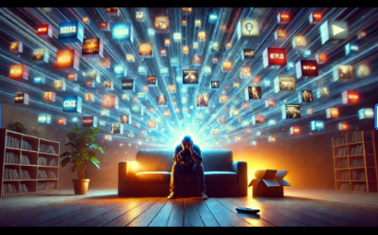
Navigating the Content Ocean
We live in an era of content abundance. Platforms like Netflix and Amazon Prime host thousands of titles.
The Problem: "Analysis Paralysis." Users spend more time searching than watching.
The Cost: Without guidance, users get frustrated and churn (cancel subscriptions).
The Solution: Automated filtering that curates a manageable, personalized list.

Slide 3
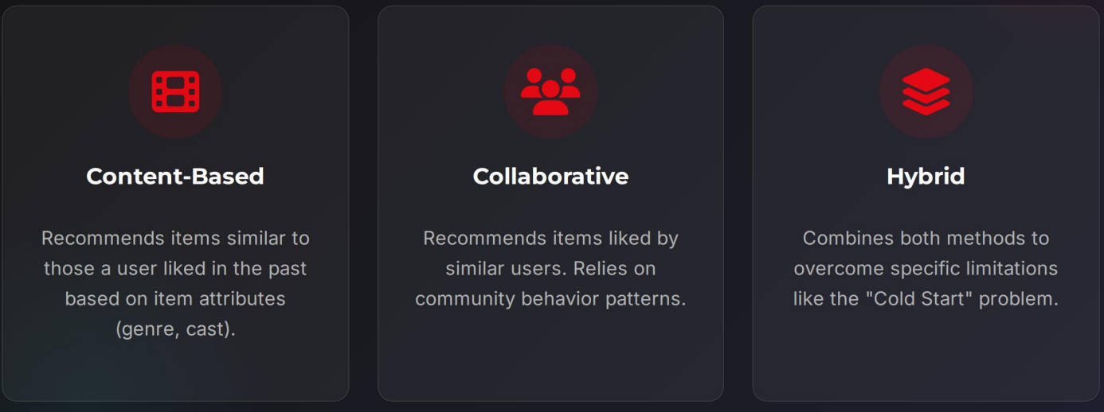
The Big Three

Slide 4
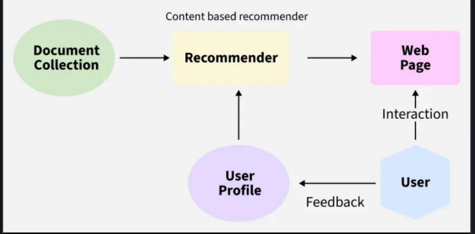
Content-Based Filtering
"If you liked The Matrix...”
This method builds a profile of the user's interests based on the metadata of movies they've watched.
Features: Analyzes Genre (Sci-Fi), Director (Wachowskis), Actors (Keanu Reeves), and Keywords (Simulation).
Logic: "User A likes 'Action' and 'Sci-Fi'. Inception is 'Action' and 'Sci-Fi'. Recommend Inception."
Pro: No need for other users' data.

Slide 5
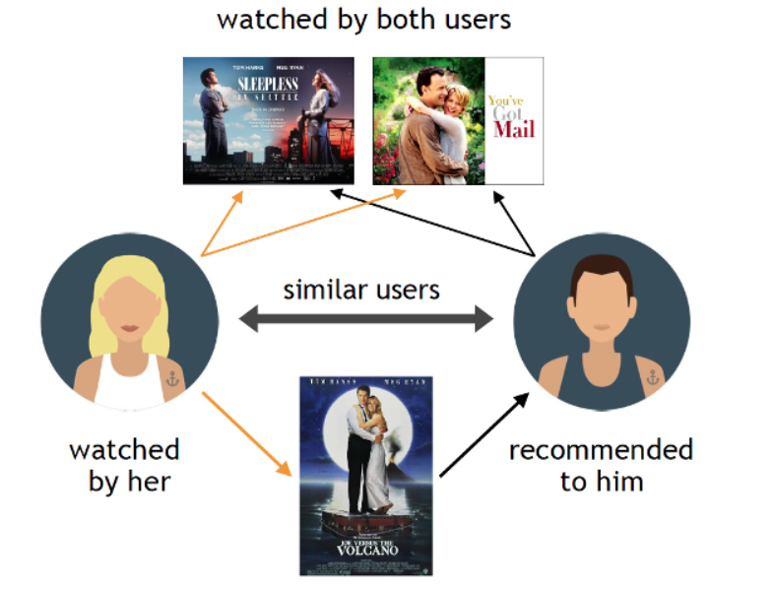
Collaborative Filtering
"The Power of the Crowd"
This technique relies on the assumption that people who agreed in the past will agree in the future.
User-User: Find users similar to you. If they liked Titanic, you might too.
Item-Item: Find items that are often watched together. "Users who bought this also bought..."
This allows for serendipitous discovery-finding content outside your usual genres.

Slide 6
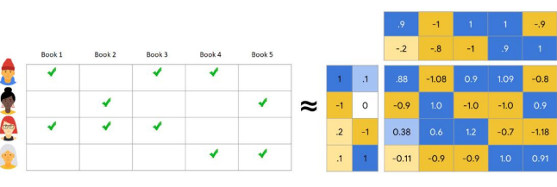
Under the Hood: Algorithms
Matrix Factorization
A powerful technique used to discover latent features underlying the interactions between users and items.
User-Item Matrix: A giant grid where rows are users and columns are movies. Most cells are empty (sparse).
Dimensionality Reduction: Techniques like SVD (Singular Value Decomposition) break this matrix down to find hidden patterns.
Similarity Measures: Algorithms use Cosine Similarity or Pearson Correlation to calculate how close two vectors (users or items) are in space.

Slide 7
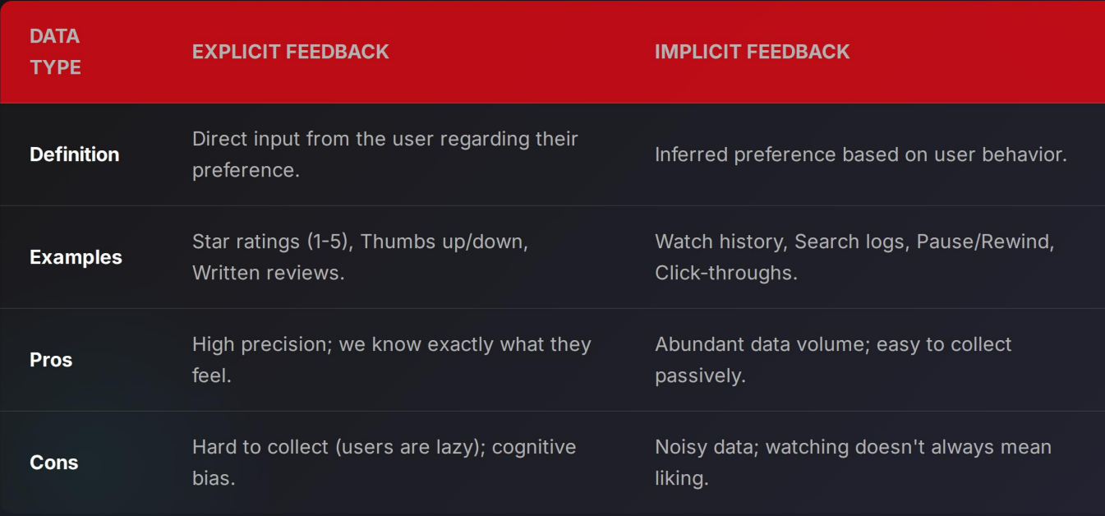
Fuelling the Engine: Data

Slide 8
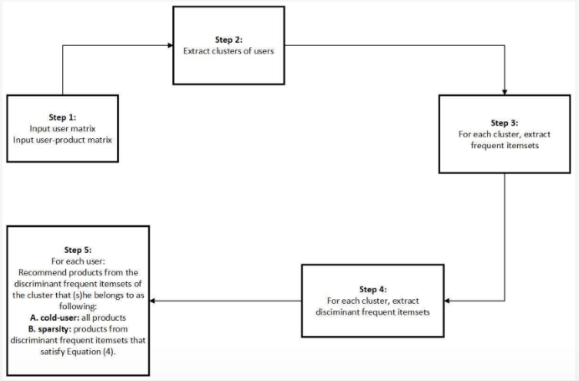
The Cold Start Problem
The New User Dilemma
How do you recommend movies to a user with no history? Or recommend a new movie that has no ratings?
Solutions:
Trending Lists: Recommend globally popular items initially.
Onboarding: Ask users to select 3-5 favorite genres/movies upon sign-up.
Metadata: Use content-based filtering for new items until enough interaction data is gathered.

Slide 9
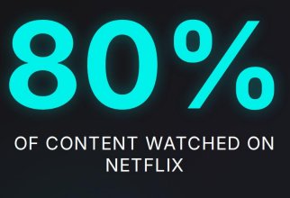
Why It Matters
Driven by Recommendations
The vast majority of viewing choices are not result of search, but of algorithmic suggestion.
Retention: Reduces churn by constantly surfacing relevant content.
Catalog Usage: Helps surface "Long Tail" content—older or niche movies that would otherwise be forgotten.
Financial Impact: Netflix estimated its recommendation engine saves over $1 Billion annually in customer retention.

Slide 10
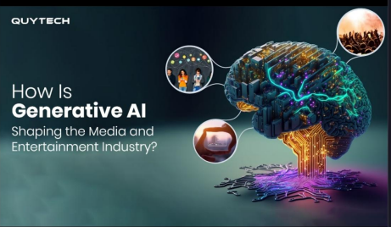
The Future of Recommendations
Context & Al
The next generation of engines goes beyond simple history.
Context-Awareness: Recommendations based on time of day, device, location, or even inferred mood.
Deep Learning: Neural networks analyzing video frames and audio directly to understand content vibes.
Generative Al: Creating personalized summaries, trailers, or even generating custom content to bridge gaps in the catalog.

